Slide 1
CMIL Patching Ideas
Emma Smith

Slide 2
Consideration
How is the normal being calculated? What ensures it is going in the correct direction?
Is the tangent calculated from one pair of points or an average?
Notes:
because the tangent is made from a line between two points, there is no information about the contour used in creating the tangent or normal

Slide 3
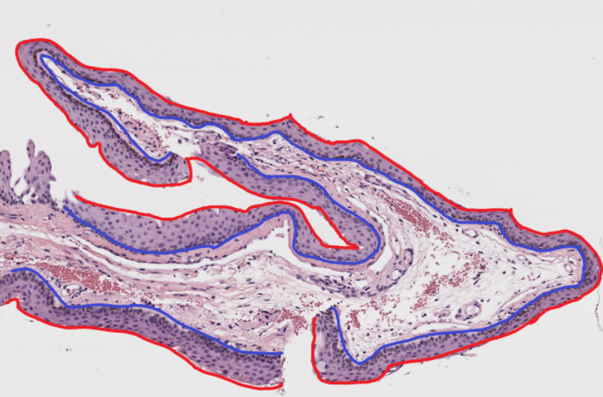
Differentiate contour
internal/external
Use same algorithm with adjustment
Only create patch if normal intersects both interior and exterior contour
Benefits
Removes patches that don't cover the entire width
Help make sure normal is correct direction
Possibly help with small patch problem
Reduce redundancy of creating patches from both sides of the epithelium
Reduces the amount of patches to process

Slide 4
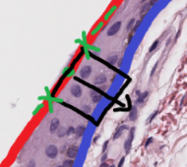
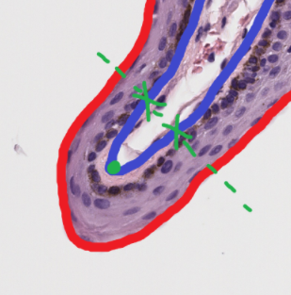
Possible Adjustments
If not already, average tangents
Weighting tangents made from points closer
Reduce the effect of far away points on pin-curves
Correct/filter patches before removing overlapping
Distance between two points that create tangent should be approx. width of patch
If not, there will be excess stroma or white

Slide 5
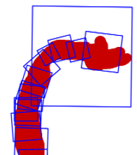
Other Ideas
More methodical approach to removing overlapping
Patches are sequentially checked if there is overlap so at the end if there is too much overlap, patches are omitted leaving the gaps at the start
There may be multiple combinations of patches, find the best one
Rank quality of patches, add to set from best to worst given overlap parameter is satisfied
Methodical way to find a good starting patch (distance calculation)
Pick the combination that covers the most area
Binary approach: Start with point, move a large range and add patch, and then fill in inbetween
Notes:
If the large patch is the start, many good patched will be omitted

